Slide 1


Android Bootcamp: Simple to do APP
By Michael Gonzalez
10/24/2021

Slide 2
Overview
Set up project
Design Requirements
Model-View-Controller
Paper/Wireframe Prototype
Tasks & Sub-Tasks
Android Studio Layout & UI Tools
Next steps

Slide 3

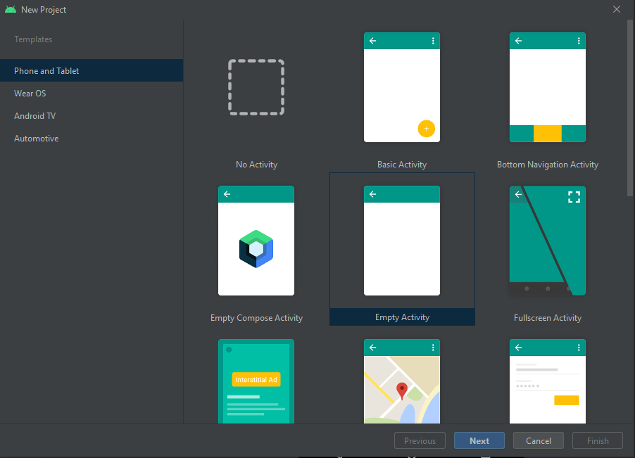
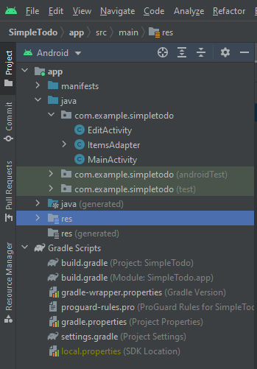
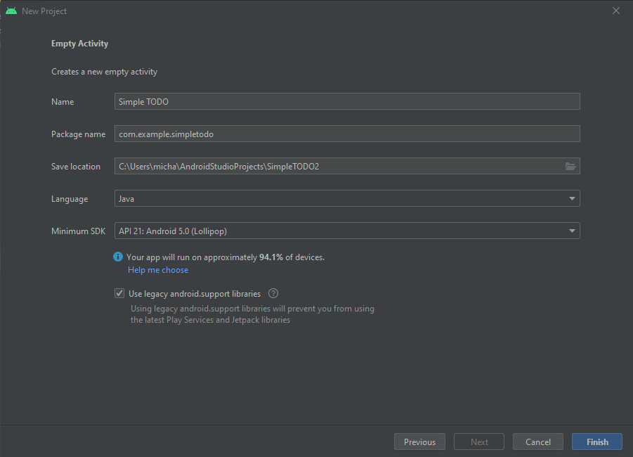
Set up project
Create a new project
Empty activity
Name our project
Select Java
Select latest SDK
Allow us to develop to a wide variety of devices
We are now able to work in our project’s directory as well as see all the available files that were created as well as edit them.

Slide 4
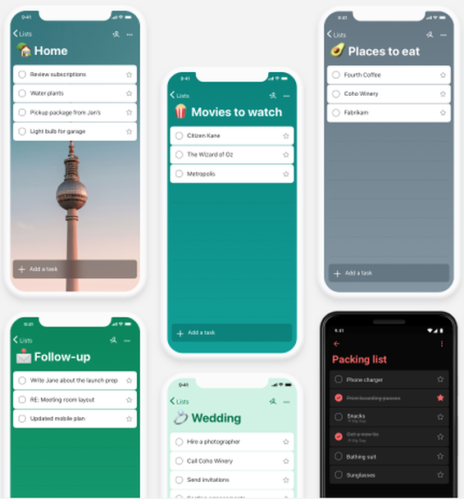
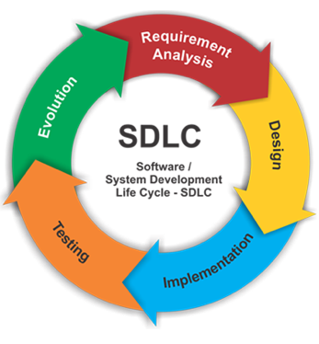
Scoping the To-do App
Main objectives of our app (or requirements):
View list
Add new item
Remove item
Remember CRUD:
Create
Read
Update
Delete

Slide 5
Design Framework: Model-View Controller
Model
Updates
Manipulates
A design pattern that helps us divide and identify the app’s functions
Model: Structured data
Underlying logic
Data structures
View: The user interface
Model’s representation of data (Controls & Containers)
Controller: Functional implementation
Control logic for Add/Remove, Load/Save, wiring the model view
View
Controller
Sees
Uses
User
Notes:
View : , how the model is represented to the user

Slide 6
Paper/Wireframe Prototype
List of Tasks & Sub-tasks
(TOP) Create basic label with app name
(Middle) basic view of items
Add list view for items
Functions: press and hold to remove item
Update List (adding or removing)
(Bottom) Add new items
Add Input text
Add “Add” Button
“Add logic”
Project Label here
(TOP)
(Middle)
(Bottom)
Item #1
Item #2
Item #3
Item #4
Item #5
Item #6
Item #2
Insert Item here…
Add
Notes:
(TOP) basic label with app name
(Middle) basic list of items
Vertically Scrollable
Functions: press and hold to remove item
Bottom) Add new items
Input text
Add Button

Slide 7
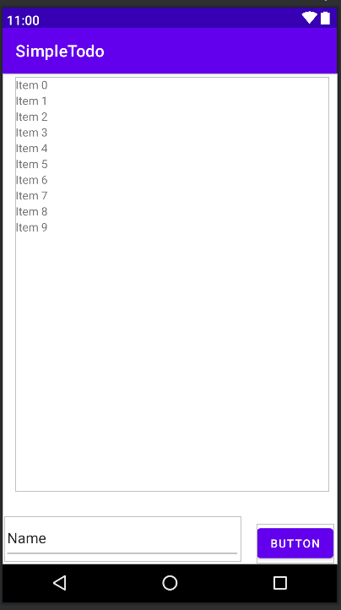
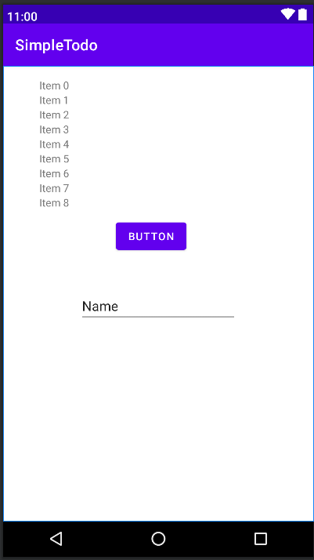
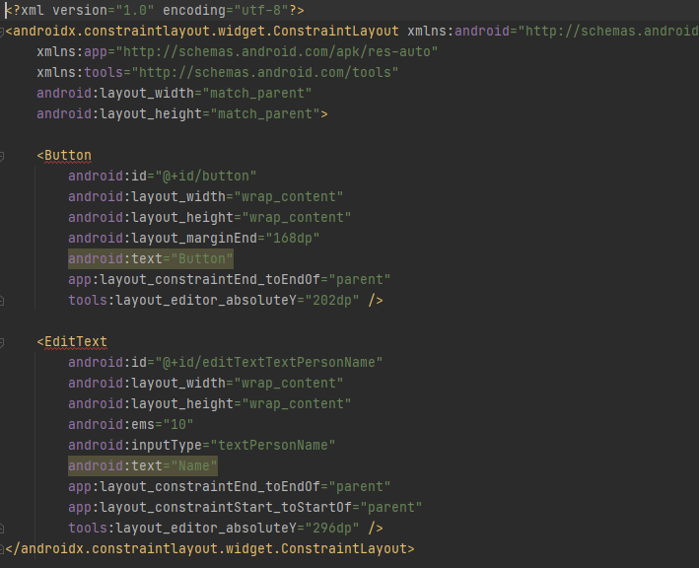
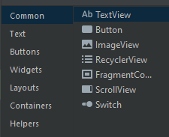
User interface
Modify strings.xml
Add button and input text using the input pallet
Add recycler view
Paper prototype replica: COMPLETE
Notes:
Strings.xml is found under the values folder in the res directory, same place where the layout folder is
Modify strings.xml
Add button and input text using the input pallet
Add recycler view
Paper prototype replica: COMPLETE

Slide 8
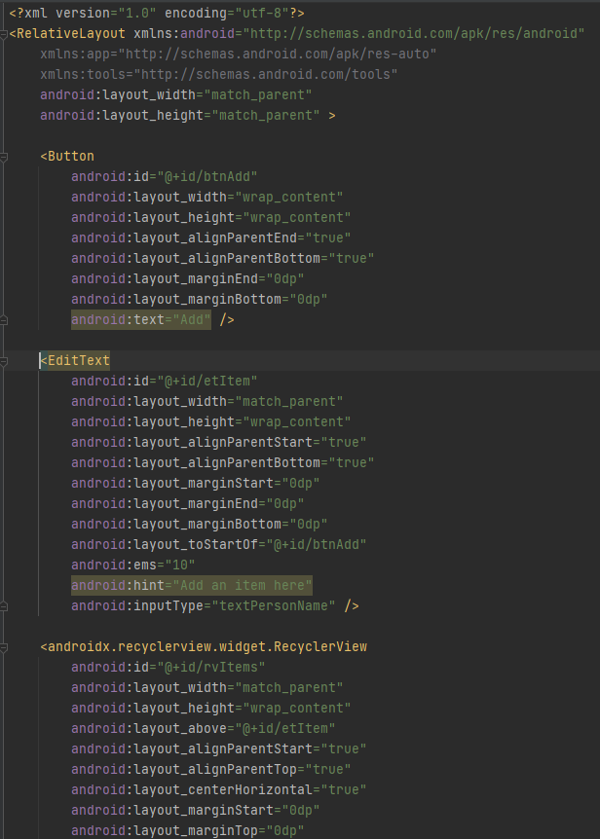
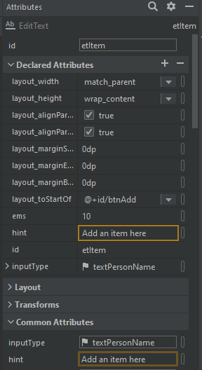
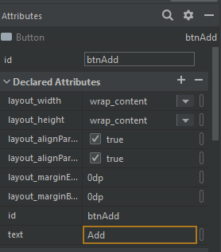
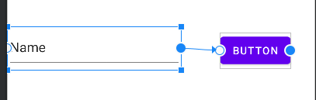
Constraints & values
Each item can be constraint relative to other items
Every item has unique attributes such as: id, text, width, height and so on

Slide 9





Thank you

Slide 11
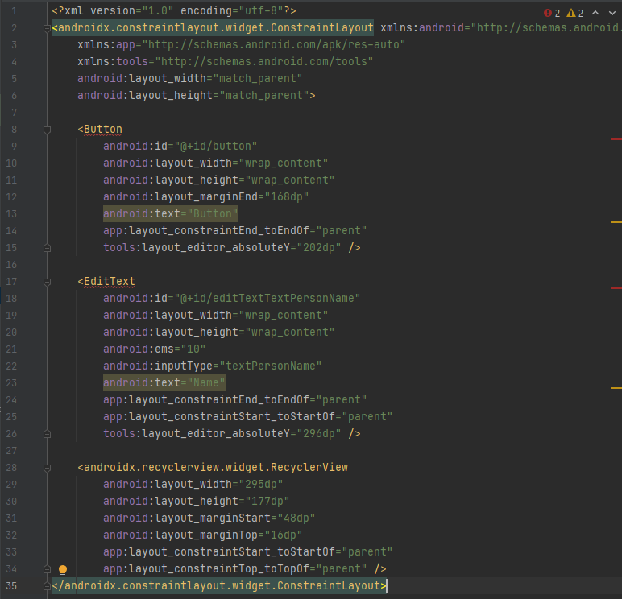
Extra code slide

Slide 12
Before we code things to know
We will be using java to code
We need to go a quick overview of the required data structures so that we can use them effectively, explain some popular ones but don’t go down why they are used or efficiency unless asked

